Slide 1
STAYING SAFE AGAINST COVID-19 IN PUBLIC AND PRIVATE ROAD TRANSPORTATION IN LAGOS STATE
OGOCHUKWU UGBOMA Ph.D.

Slide 2
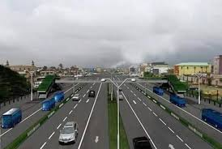
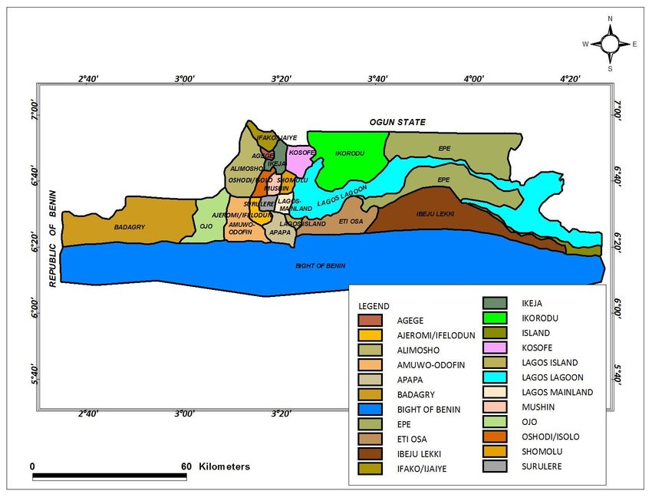
Lagos Road Transport - A Glance
Population: circa 20 million
Public roads: 7,598.1km
Federal roads: 468.6km
State roads: 1,287.17 km
Local government roads: 5,843.77km
Registered Vehicles: >5,000,000 vehicles
Commercial Vehicles: approx. 200,000 vehicles
Daily Demand (passengers/day): 200,000 pax
Predominantly road-based
45% of daily total pax traffic – Danfo
40% of daily total pax traffic – walk
2% of daily total pax traffic – BRT+LagBus
11% of daily total pax traffic – Private cars
22 million pax traffic/day

Slide 3
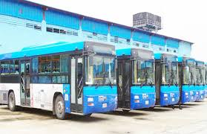
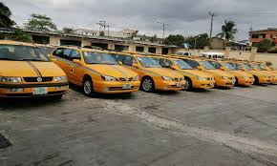
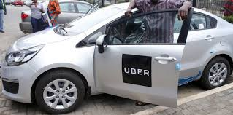
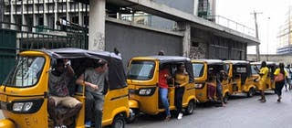
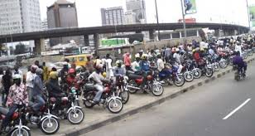
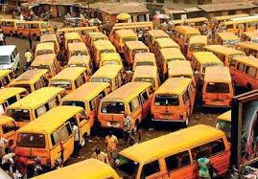
Public Transport Operators
BUS RAPID TRANSIT (BRT)
YELLOW TAXIS
E-HAILING TAXIS
KEKES
MOTORCYCLES (OKADA)
YELLOW BUSES (DANFO)

Slide 4
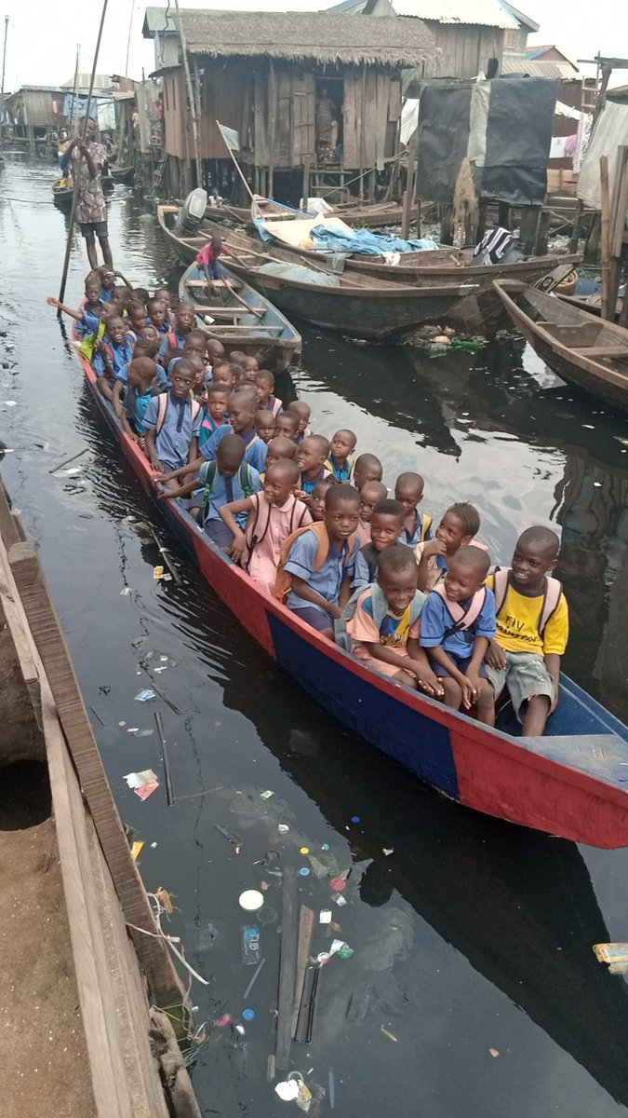
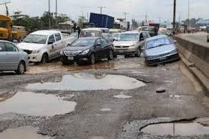
State of Public Transport in Lagos
Inappropriate fleets of public transport vehicles
Inadequate infrastructure to support rolling stock – overcrowding at bus stops and boarding stations
Informal Operational Structure
Lack of organized private sector participation
Dilapidated road networks
Poor drivers’ behaviour and public transport indiscipline
Unsafe vehicle conditions
Notes:
With the formal public transportation contributing only 2.75% of daily mobility in the city, it is clear that these modes cannot meet the demand of the Lagos residents, hence semi-formal and informal operators from mini buses (danfo), motorcycles (okada), tricycles (keke Marwa) and boats (example of Makoko community) sectors will continue to fill the gap. Underlying the need to fill this mobility gap by the informal operators are unemployment and high poverty rate in the city and not necessarily as a choice career or grounded profession. The incursion into the transportation sector by the unemployed youth and other categories of the population who seek means of livelihood has contributed to traffic chaos and unethical behavior among the informal operators.
Many inner roads in Lagos are in poor condition

Slide 5
Government Interventions in the Face of COVID-19
Public transport operations within the state shall be between the hours of 6.00a.m and 7.00p.m daily
Suspension of inter-state operations
Indefinite suspension of the operations of commercial motorcycles, popularly known as “Okada”
Commuters were mandated to wear face mask at all times, sanitise their hands with alcohol-based sanitisers or wash their hands with soap and running water before and after each trip
All transport operators/companies are expected to disinfect their vehicles, parks and garages regularly and continuously in collaboration/supervision of the Ministry of the Environment and Water Resources to ensure standards and safety of the disinfectant being used
All transport operators/companies are expected to have at the entrance of their respective parks handwashing equipment with running water and alcohol-based sanitisers

Slide 6
Government Interventions……..
Operators are expected to have alcohol-based sanitisers in their vehicles for both drivers, conductors and passengers
Motor parks and garages must not be overcrowded with passengers and commercial activities at any point in time
Social distancing was required for passengers queuing to board buses
All public buses should be 60 per cent capacity (i.e for buses; one passenger with driver in front seat, two passengers on the back rows for tricycle)
NCDC recommendation that at least 2m (6feet) distance is required between people; operators are not allowed to over crowd/over load their vehicles
Staggering of market days

Slide 7
Current Situation in Line with Government Directives
Indiscipline
Low enforcement
No punitive measures
Informal Sector
Covid still a myth
Poor management & technical capabilities
Current Situation
Bus Stops are still crowded
No handwashing or sanitizing facilities
Contact service delivery
Motorcycles still operating
Scanty use of face masks
Minimal adherence to 60% loading capacity
WHY ?

Slide 8
Suggestions to staying safe
S/N | Short term | Medium term | Long term
1. | Continual education and awareness to Covid-19 guidelines and government directives | Operators to provide update on coronavirus and its impact to commuters | Design and implement a Post-Covid 19 safety architecture for transport service delivery.
2. | Encourage Working From Home | Economic challenges faced by both passengers and operators, government to come up with ways to curb hike in fare charges | Review stock and supply chain for operational materials; fuel, lubricants, spare parts
3. | Staggering trips | Ways to check increase in private car use as people avoid public transportation | Fighting a pandemic is not a stand-alone project, so integration with existing crisis management structures is strategic
4. | Avoid contact delivery service like sale of tickets | Keep to small groups of people at any one time | Advisable to follow related communication from responsible authorities for latest updates.

Slide 9
Suggestions to staying safe…….
S/N | Short term | Short term | Long term
5. | High risk age groups to limit travel | Deployment of critical IT infrastructure | Planning for a more integrated transportation to mitigate road mode prevalence
6. | Avoid busy routes and rush hours | Management of available transport vehicles and services | Correction of land use pattern and physical planning of built environment to support walking, bicycling for inclusive and sustainable transportation.
7. | People from a household or share bubble can travel together in a private vehicle | Flexible scheduling to accommodate increased demand | In an economy of low liquidity, need for privatization in the road sector to create competitive advantage is essential
8. | Clean your car between journeys using standard cleaning products | Strengthen the capacity and resilience of employers | Provision of affordable internet facilities to encourage working from home

Slide 10
Suggestions to staying safe…….
S/N | Short term | Medium term | Long term
9. | Dispose face masks using ‘black bag’ waste bins not recycle bins. | Need for government and public transport regulators to address transport affordability, inclusiveness, social inequality and fare hikes | Ethical data harvesting using machine learning, artificial intelligence to understand travel behaviour and patterns for future planning.
10. | Avoid consuming food and drink on public transport | Protecting workers in the work place by strengthening occupational safety and health measures | Due to huge daily mobility demand, need for organized private transport operators participation in public transportation.

Slide 11
THANK YOU
CONTACT
ogochukwu.ugboma@lasu.edu.ng
@ogochukwuugboma

